Slide 1


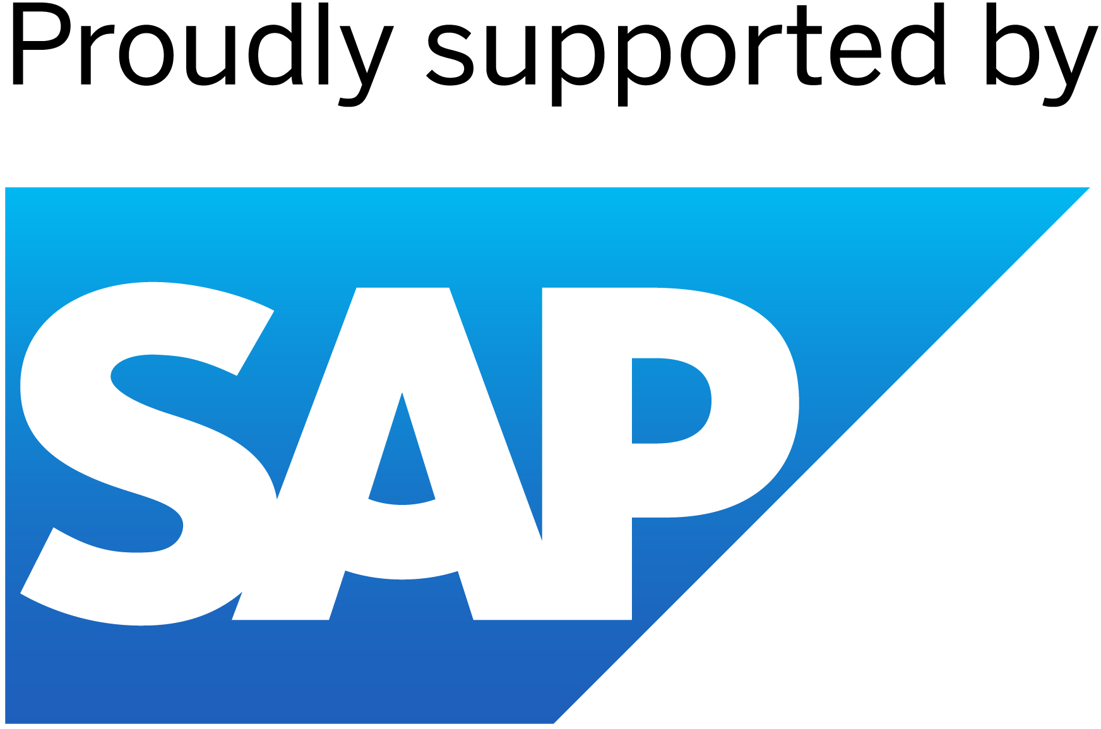


PLURA: Project Management and Dashboard
Team Members
Guide
1. Janmejay Kumar Singh
2. Satyam Kumar Jaiswal
Karan Bhat

Slide 2

PLURA: Project Management and Dashboard
Disclaimer
The content is curated from online/offline resources and used for educational purpose only

Slide 3

Course Outline
PLURA: Project Management and Dashboard
Problem Statement
Proposed Solution
Software Requirements
System Design/Architecture
Video of the Project
Future Scope
Conclusion
References

Slide 4


PLURA: Project Management and Dashboard
Problem Statement
Existing agency management solutions lack integration and customization, leading to inefficiencies and fragmented workflows. PLURA seeks to address these challenges by offering a comprehensive, white-labeled SAS application that empowers agency owners with seamless integration of key functionalities, customizable options, and a user-friendly interface, ultimately enhancing operational efficiency and streamlining business processes.

Slide 5
PLURA: Project Management and Dashboard
Proposed Solution
PLURA is a comprehensive white-labeled multi-tasking SAS application.
It empowers agency owners with a range of powerful tools and features.
Key functionalities include agency management, client onboarding, website and funnel building, and subscription billing.
PLURA offers seamless integration of these functionalities.
The platform provides a user-friendly interface and customizable options.
Its aim is to streamline business processes and enhance operational efficiency for agency owners.

Slide 6

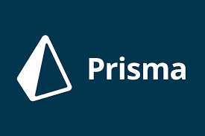
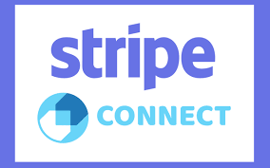


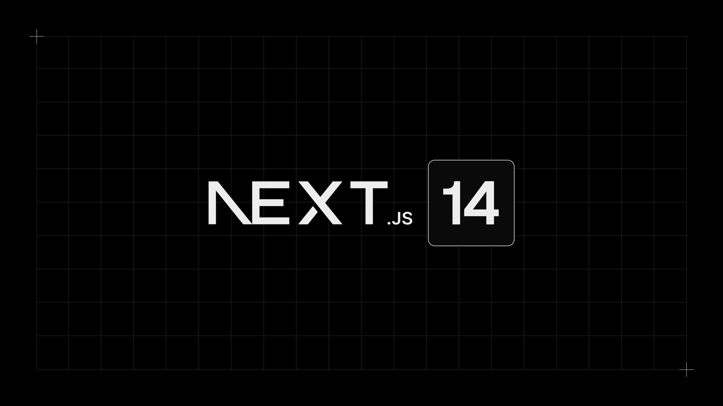

PLURA: Project Management and Dashboard
Software Requirements
Programming Language: JavaScript/TypeScript
Framework: Next.js 14
Authentication: Clerk Authentication
Payment Integration: Stripe Connect
UI Component Library: Shadcn/UI
Styling Framework: Tailwind CSS
Database Management System(ORM): Prisma

Slide 7
PLURA: Project Management and Dashboard
System Architecture
Frontend UI
Client-Side Rendering
Frontend UI
Next.js
API Gateway
Backend Microservices
Database Layer
External Integration
Deployment Environment
(optional)
for managing API endpoints
Agency Management, Billing
Stripe, Clerk Authentication
Prisma + PostgreSQL
AZURE

Slide 8
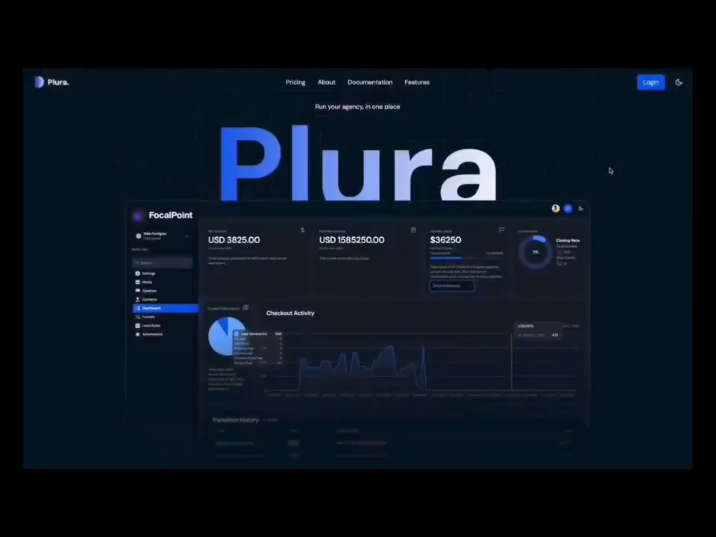
PLURA: Project Management and Dashboard
https://drive.google.com/file/d/1pZWew7G8kzNeyQFurGe5a6w7XVPBR3JT/view?usp=sharing

Slide 9

PLURA: Project Management and Dashboard
Future Scope
1. Feature Enhancements
2. Customization and White-Labeling
3. Integration with Emerging Technologies
4. Expansion of Service Offerings
5. AI-driven Personalization
6. Mobile Application Development
7. Globalization and Localization
8. Enhanced Security Measures
9. Advanced Reporting and Analytics
10. Community and Collaboration Features
11. Partnerships and Ecosystem Development

Slide 10

PLURA: Project Management and Dashboard
Conclusion
PLURA represents a comprehensive white-labeled multi-tasking SAS application designed to empower agency owners with a wide array of powerful tools and features. From agency management to client onboarding, website and funnel building, subscription billing, and more, PLURA offers a seamless and intuitive experience.
Built on a robust stack including Next.js, Prisma, Stripe Connect, and Clerk Authentication, PLURA showcases expertise in full-stack development, database management, and API integrations. Its user interface and experience emphasize responsive design, dark mode toggle, notifications, and customizable CSS properties.
Ultimately, PLURA serves as a testament to the skills and capabilities of its developers, providing real-world application experience invaluable for professional growth. Whether for showcasing proficiency in software development or meeting the needs of agency owners seeking comprehensive management solutions, PLURA stands as a testament to innovation and excellence.

Slide 11
PLURA: Project Management and Dashboard
Reference
Tereso, A.P., Fernandes, G., Lopes, A.I. (April 2024). "An integrated project management methodology under a social perspective in industrialisation projects." https://www.researchgate.net/publication/379477109_An_integrated_project_management_methodology_under_a_social_perspective_in_industrialisation_projects
Herzing, I. (December 2023). "Exploring the Connection Between Business Strategy and Project Management Tools and Techniques." https://www.researchgate.net/publication/376586588_Exploring_the_Connection_Between_Business_Strategy_and_Project_Management_Tools_and_Techniques
Alibiyeva, Z., Tsekhovoy, A. (October 2023). "METHODS AND TOOLS OF PROJECT MANAGEMENT IN RELATION TO IS DEVELOPMENT PROCESSES.“ https://www.researchgate.net/publication/378388370_METHODS_AND_TOOLS_OF_PROJECT_MANAGEMENT_IN_RELATION_TO_IS_DEVELOPMENT_PROCESSES
Clemente, M., Domniques, L. (2023). "Analysis of Project Management Tools to support Knowledge Management." Procedia Computer Science, Volume 219, Pages 1769-1776. Retrieved from: https://doi.org/10.1016/j.procs.2023.01.472

Slide 12
PLURA: Project Management and Dashboard
Thank you!

